Slide 1

Electrolysis and Material Storage of Hydrogen Gas
Notes:
Hannah
Welcome and thank you for coming to embry-riddle hydrogens design concept review. Our project focuses on hydrogen technology, specifically electrolysis and material storage of hydrogen

Slide 2







Team Members
Hannah Spiller
Design Team Lead
Dylan Astrup
Lead Human Factors Engineer
Grant Carrabine
Lead Electrolysis Engineer
Tesla Alford III
Lead Extraction Engineer
Titan Berson
Lead Interface Engineer
Jacob Wolf
Lead Piping Engineer
Notes:
Hannah and kinda us
My name is Hannah Spiller, I am the design team lead, and this is my team.

Slide 3







Agenda
Introduction
Problem
Solution
Subsystems
Budget
Timeline
Conclusion
Notes:
;SHannah
The agenda of today’s presentation will be… Introductions, introducing the problem, our proposed solution, providing all of our evidence, going over the budget, explaining the timeline, and finally conclusions

Slide 4
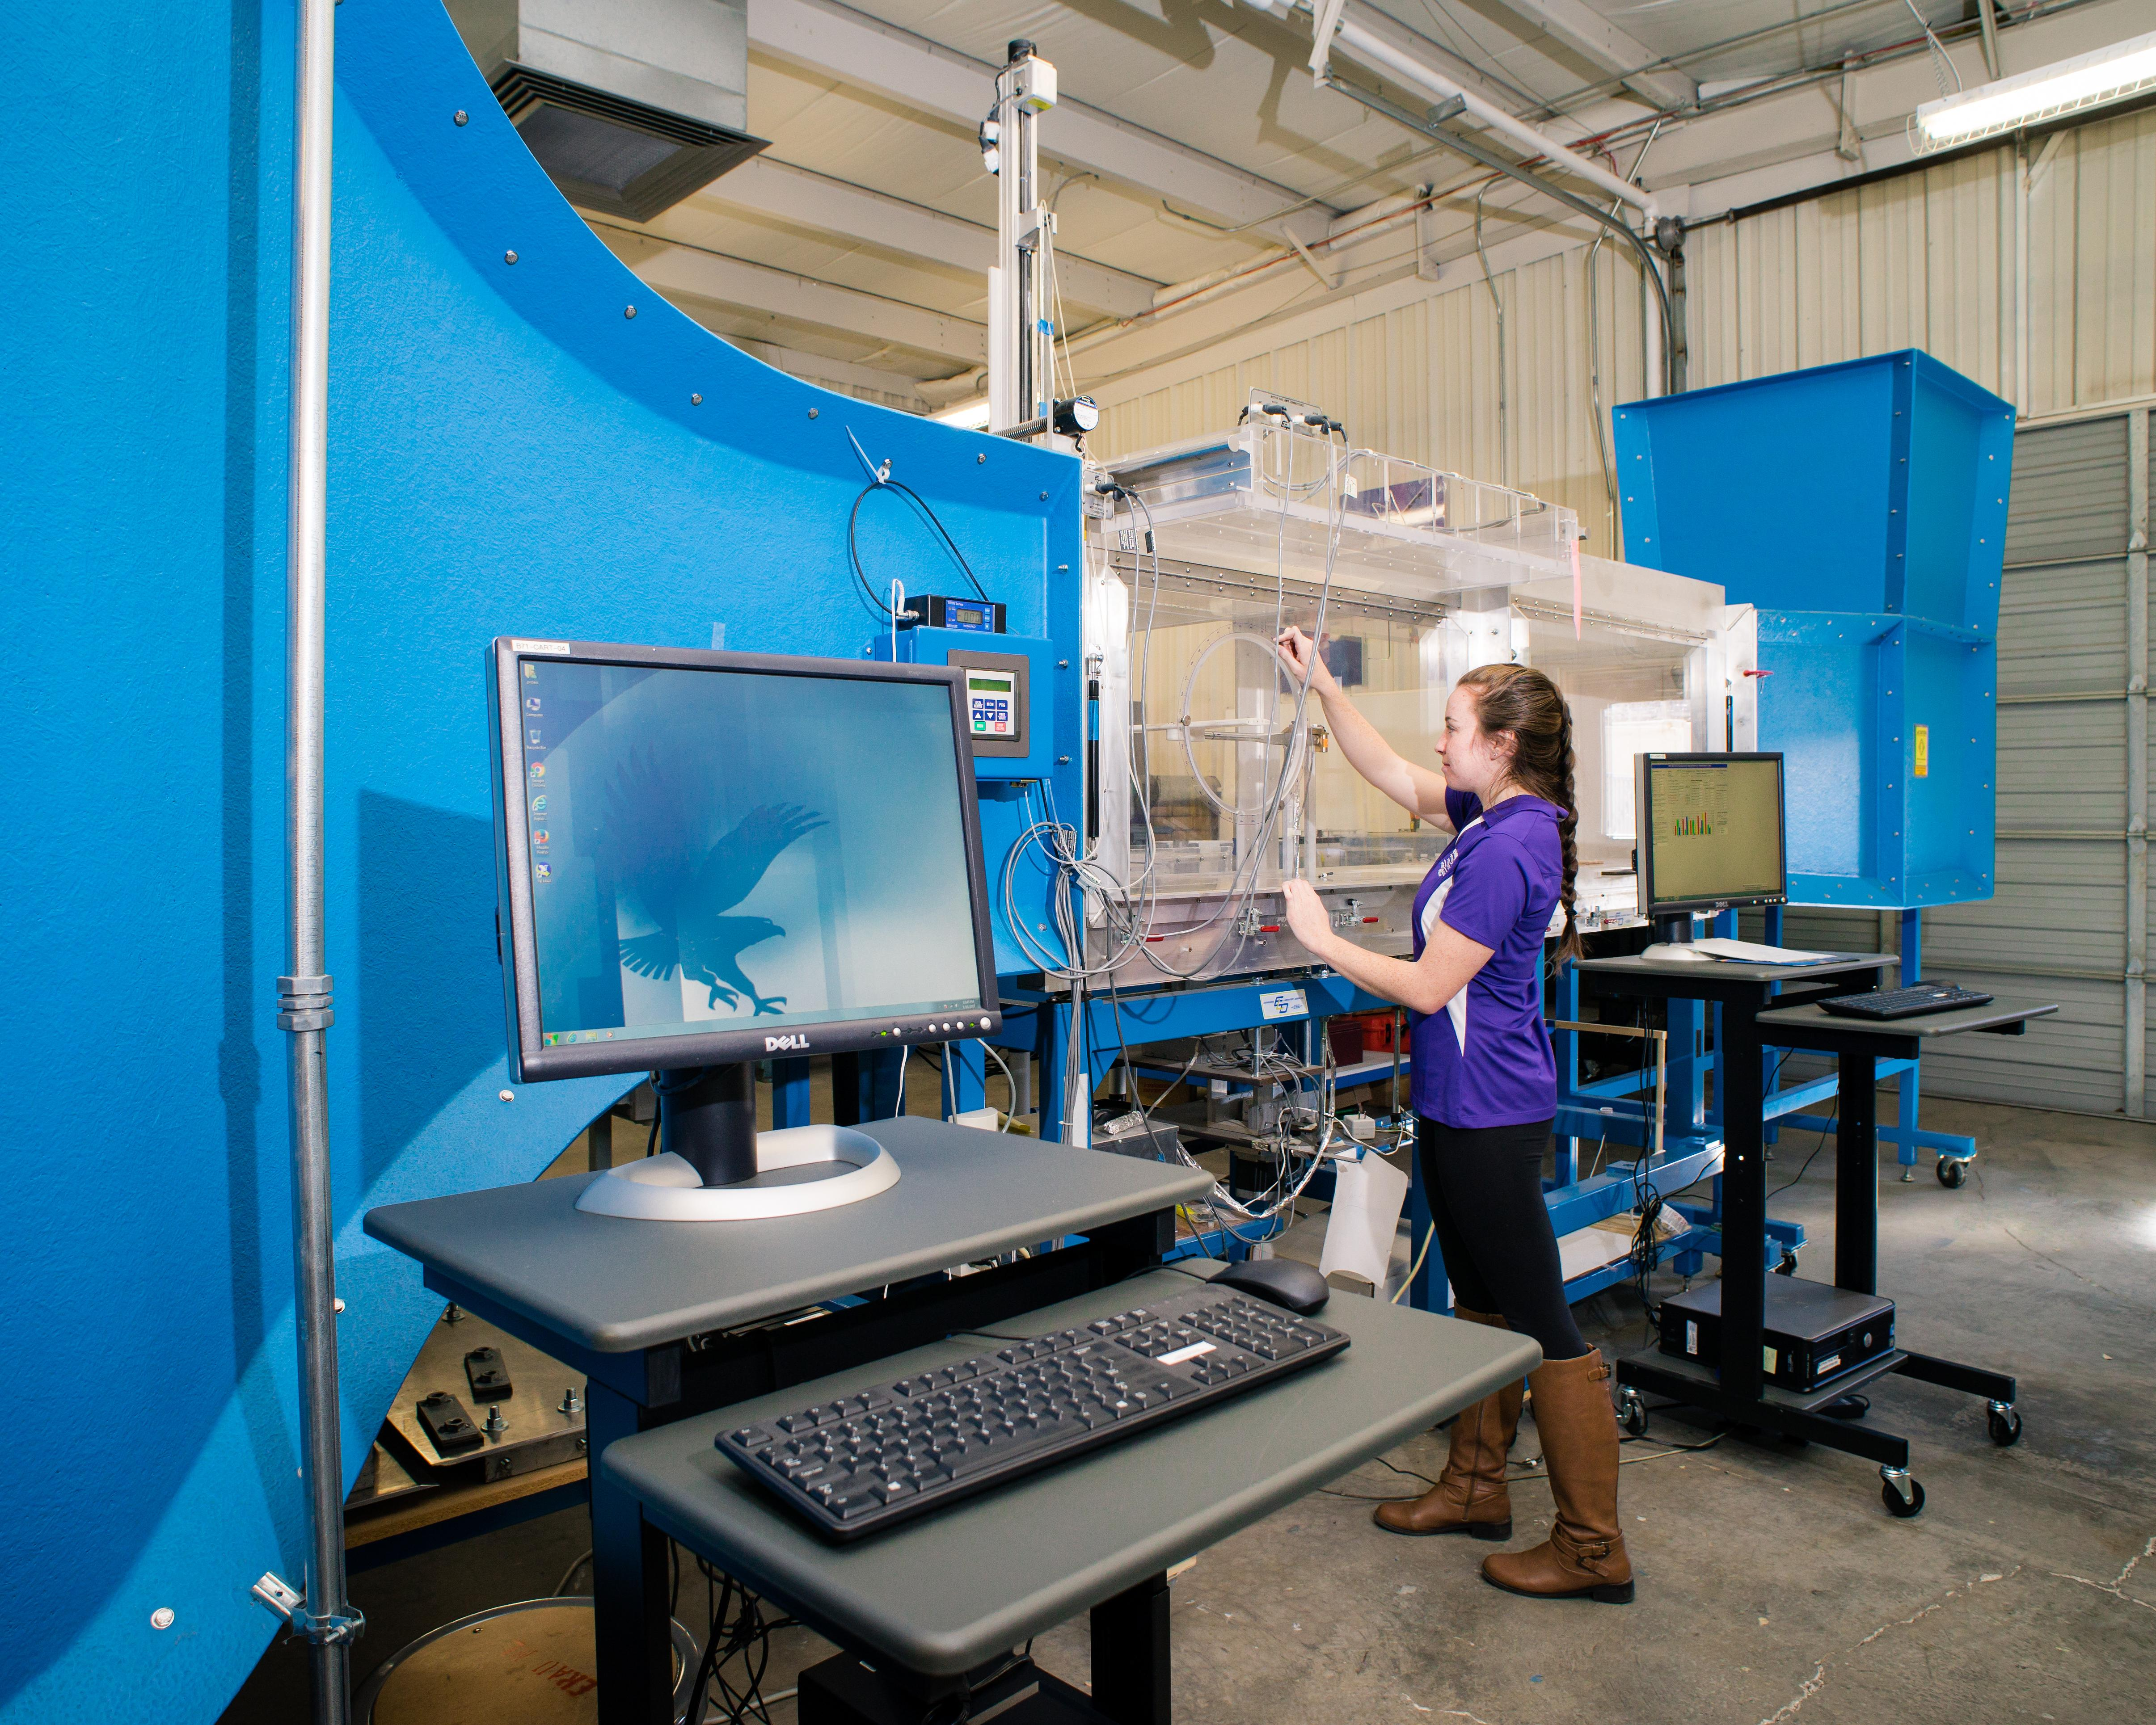
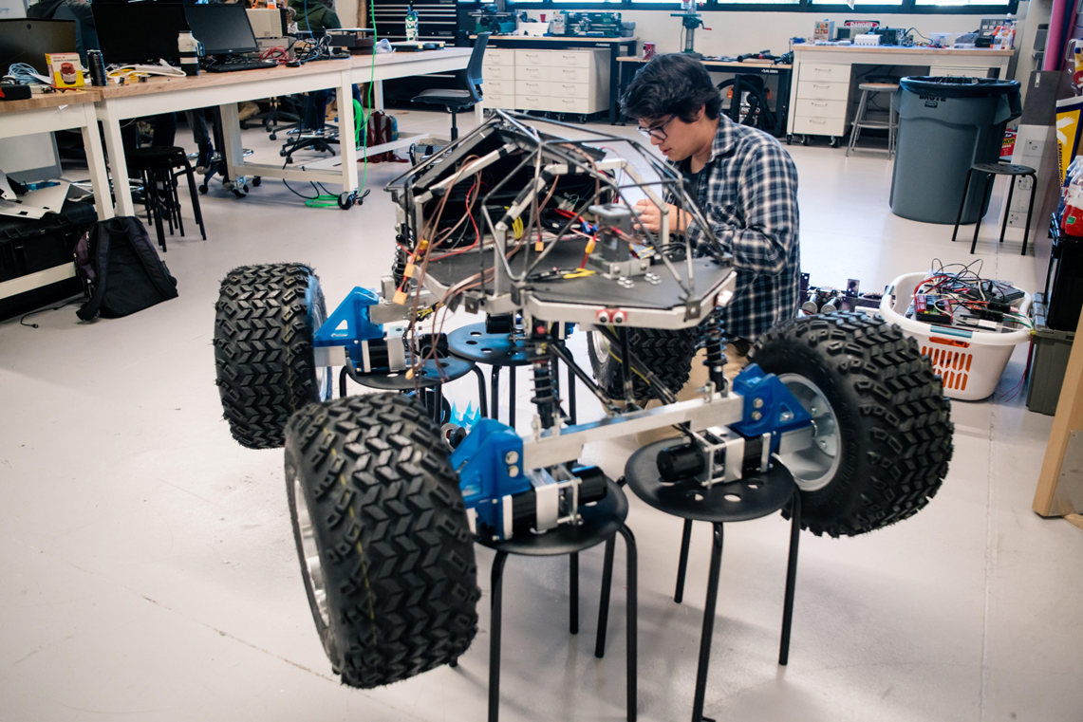
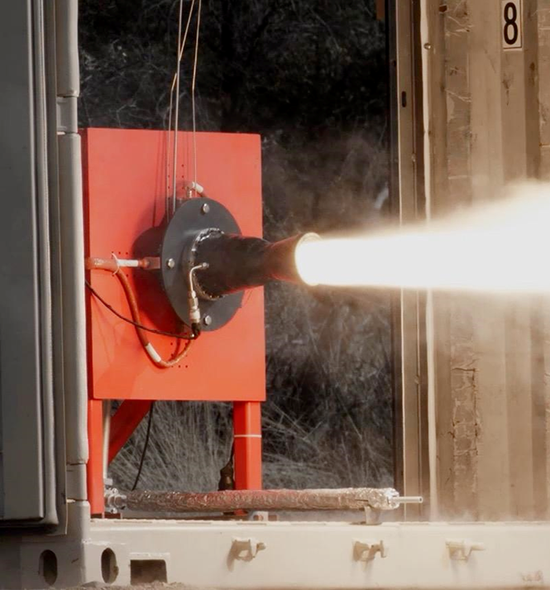
What Embry-Riddle Has
Wind Tunnel
Robotics Lab
Propulsion Lab
Notes:
Jacob
Nancy and tracy doryland wind tunnel

Slide 5
Embry-Riddle does not have
Energy Labs
Energy Classrooms
Viewable Demonstrations
Notes:
Jacob

Slide 6


DOE Research into Hydrogen
The DOE is researching multiple uses for hydrogen gas, producing the need for more hydrogen. This creates interest within Embry-Riddle to create an alternative energy demonstrator that teaches the general public about hydrogen fuel and storage.
Amount: $32 million
Notes:
Tesla

Slide 7
Generate and Store Hydrogen
ERH2’s purpose is to create a demonstrator to generate and store hydrogen.
Notes:
Dylan

Slide 8
Benefits of ERH2 System
Alternative Energy Storage
Scalable Production Rate
Sole Source of H² on Campus
Notes:
Dylan

Slide 9
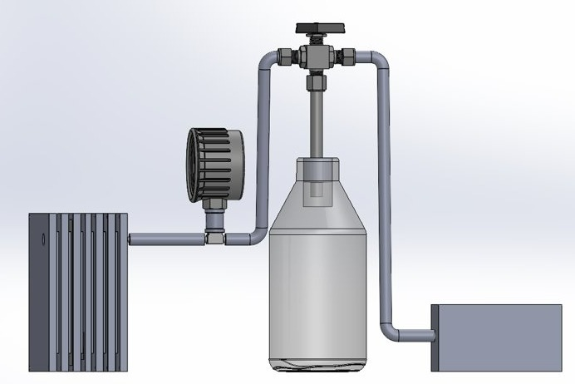
The ERH2 System
Diverting Valve
Pressure Gauge
Electrolysis
Material Storage
Fuel Cell
Nichrome Wire
Notes:
Tesla

Slide 10
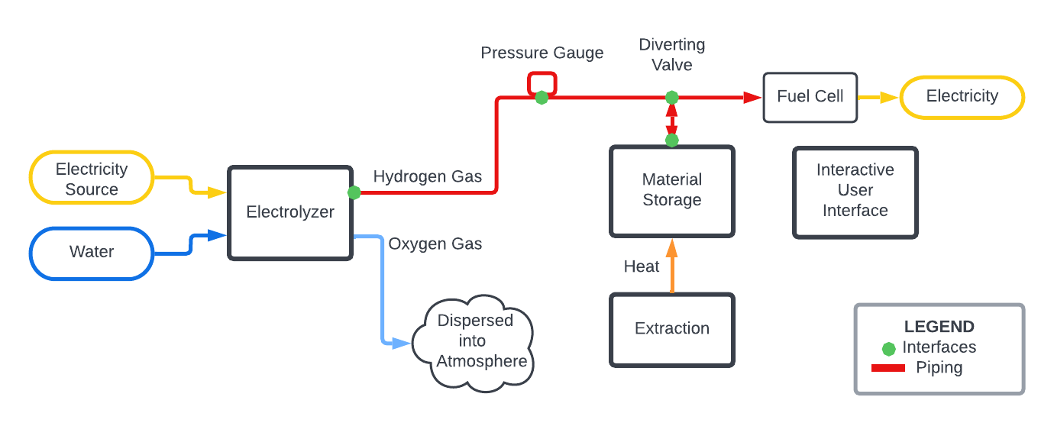
Process Flow Diagram
Simplified PFD
Notes:
Jacob

Slide 11
Critical System Requirements
Produce 0.02 grams of hydrogen over 10 minutes
Store 0.04 grams of hydrogen
Safely extract hydrogen from system
Internal components visible
Notes:
Hannah

Slide 12
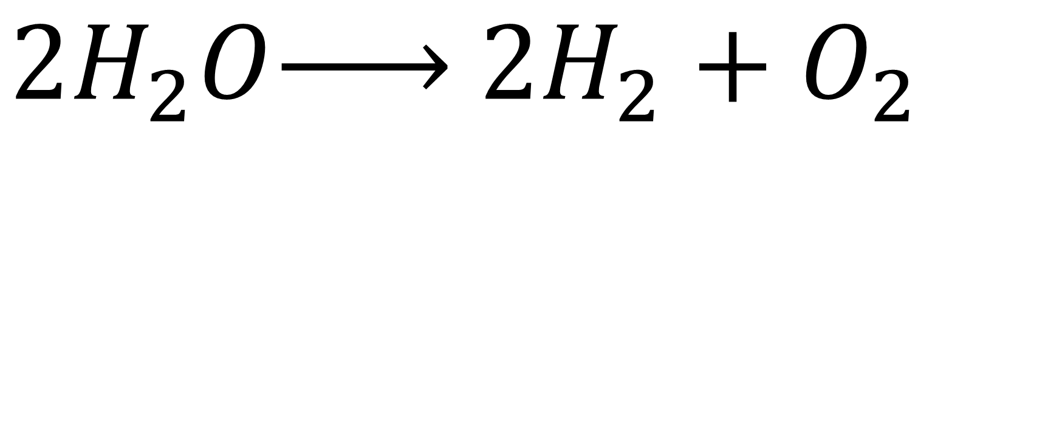
Electrolysis Equation
$2H_{2}O\underset{→}{ } 2H_{2}+O_{2}$
Notes:
Titan

Slide 13
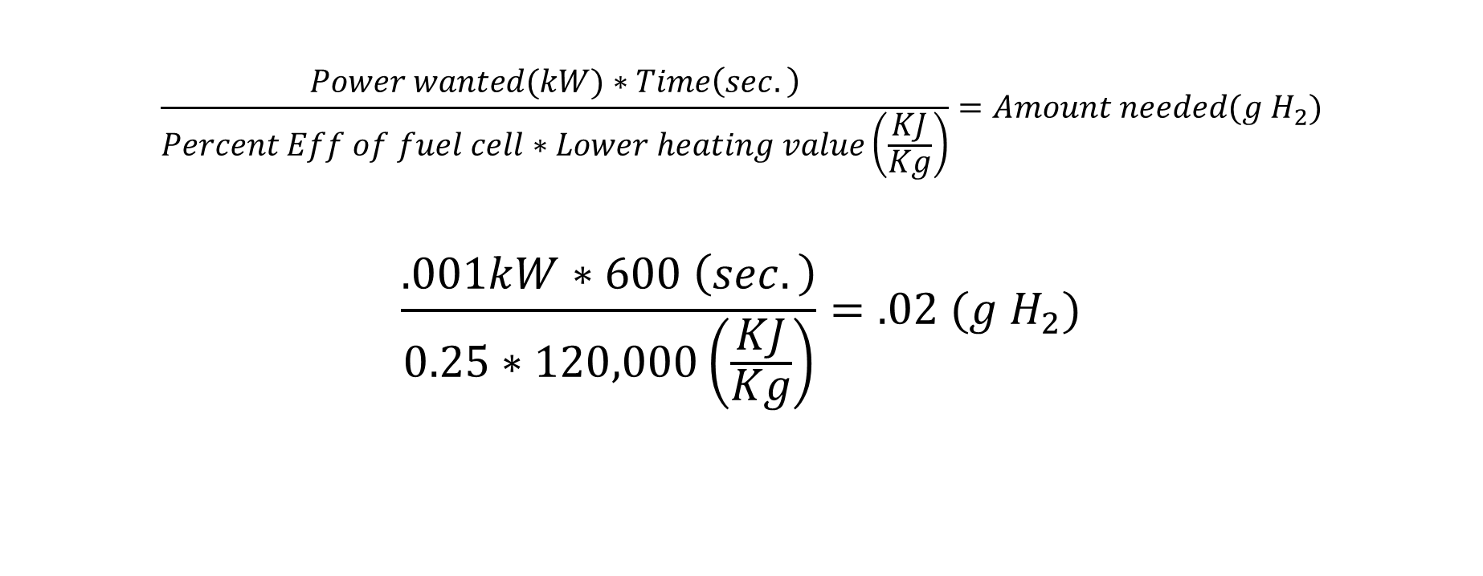
Hydrogen Production Requirement
$$\frac{Power wanted(kW)∗Time\left(sec.\right)}{Percent Eff of fuel cell∗Lower heating value\left(\frac{KJ}{Kg}\right)}=Amount needed(g H_{2})$$
$$\frac{.001kW∗600 \left(sec.\right)}{0.25∗120,000\left(\frac{KJ}{Kg}\right)}=.02 (g H_{2})$$
Notes:
Grant
Calcs on what is need to run the fuel cell at 1 w for 10 minutes
We use National renewable energy laboratory

Slide 14

Electrolysis
Notes:
grant

Slide 15
Subsystem Requirements
6.1 The hydrogen and oxygen produced in the electrolysis system must not mix.
6.2 The electrolysis system housing layers must be replaceable.
6.3 The electrolysis system housing must be resealable.
Notes:
21

Slide 16
Subsystem Requirements
6.4 The electrolysis system housing must not be electrically conductive.
6.5 All wires must be insulated and sized according to the National Electrical Code.
6.6 The amperage applied to the electrolysis system must not exceed 20 amps.
6.7 The electrolysis system must have an emergency kill switch.

Slide 17
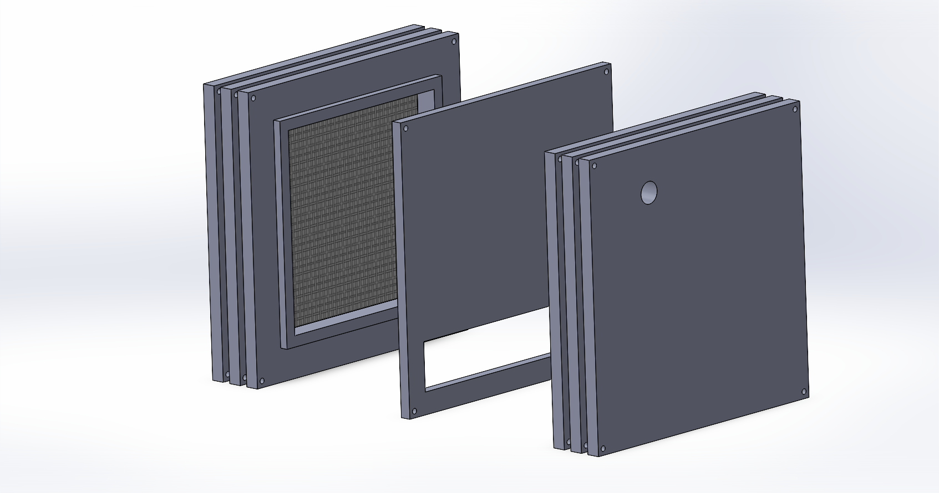
Electrolysis Breakdown
Hydrogen
Plexiglass Divider
System fastened by bolts for changing layers [6.2]
Oxygen
Rubber tape between layers to seal [6.3]
Nickel Mesh
Water reservoir channel below water level for sealing [6.1]
Model of ERH2’s planned Electrolyzer
Notes:
Grant
21.76 cubic in

Slide 18
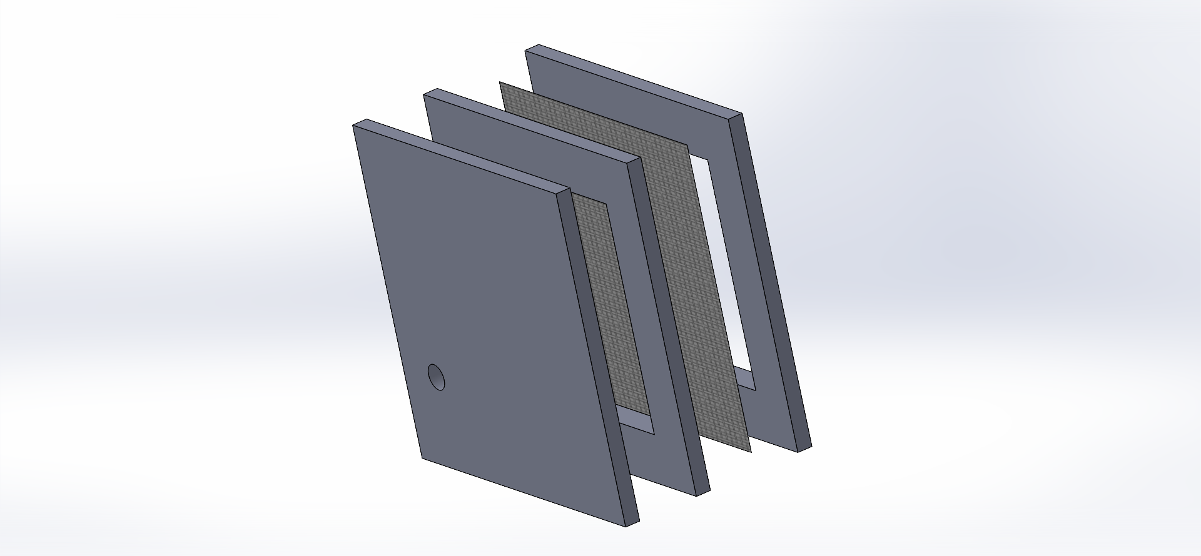
Mesh Section-View
Plexiglass
Empty Area will be filled with water
Hydrogen
Nickel Mesh

Slide 19

Power Supply
20-24 Amps
60 Volts
Amperage Control [6.6]
Kill Switch [6.7]
Notes:
https://www.amazon.com/Adjustable-Converter-Switching-Regulated-4-Digital/dp/B09QZ1R84M/ref=sr_1_3?keywords=Lab+Power+Supplies+20+amps&qid=1669946118&s=industrial&sr=1-3&ufe=app_do%3Aamzn1.fos.c3015c4a-46bb-44b9-81a4-dc28e6d374b3

Slide 20
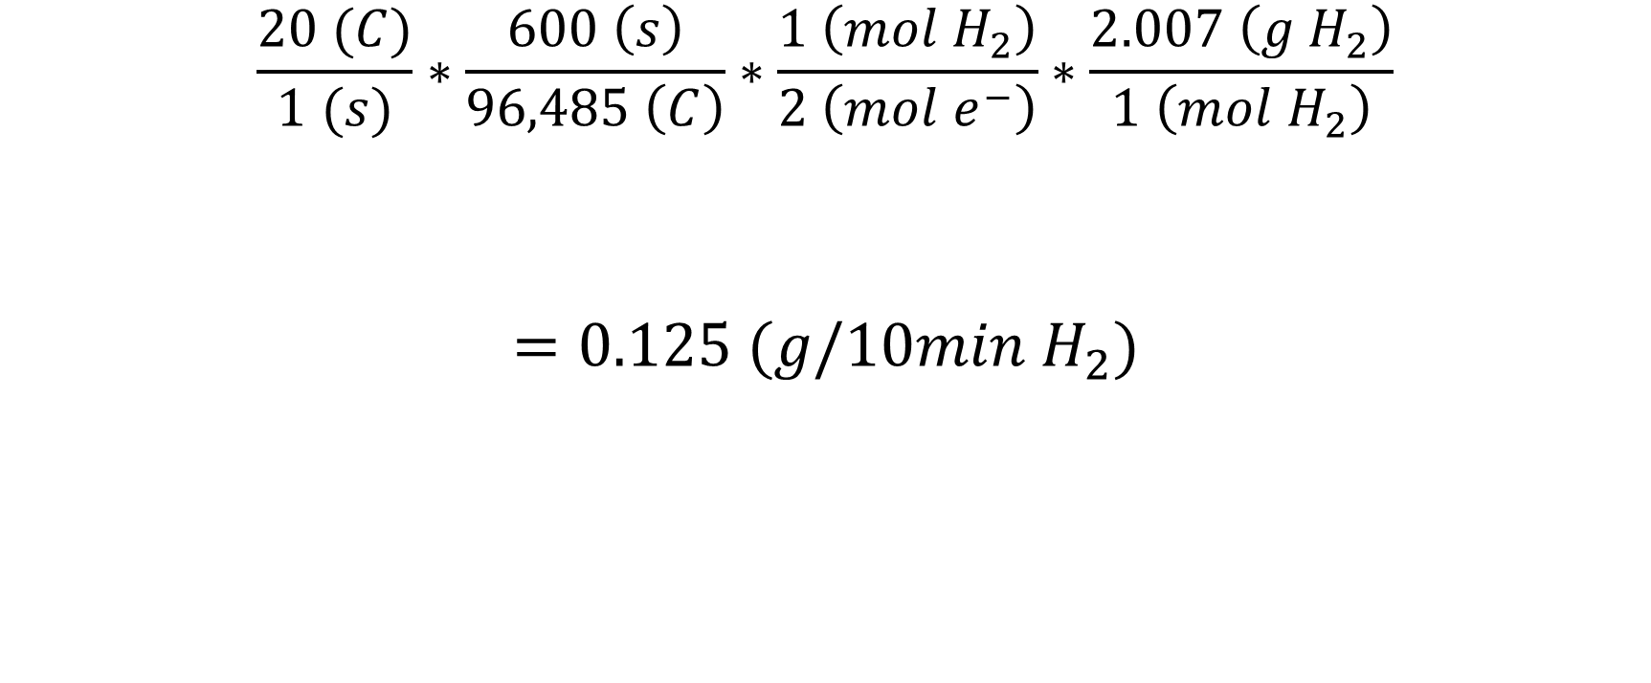
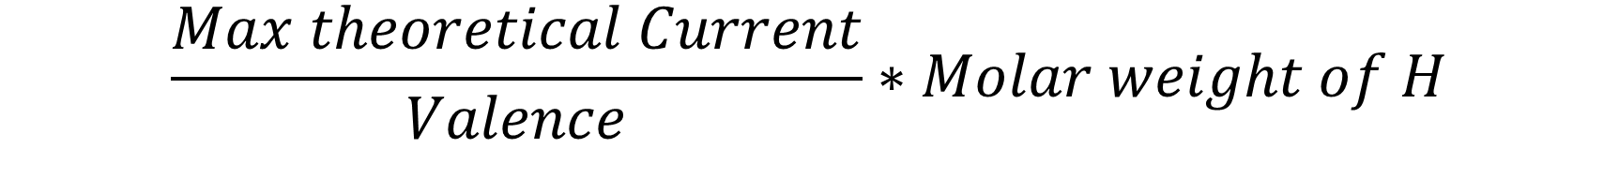
Faraday’s Law of Electrolysis Rate of H2 Production
$$\frac{Max theoretical Current}{Valence}∗Molar weight of H$$
$$\frac{20 (C)}{1 (s)}∗\frac{600 \left(s\right)}{96,485 \left(C\right)}∗\frac{1 \left(mol H_{2}\right)}{2 \left(mol e^{−}\right)}∗\frac{2.007 \left(g H_{2}\right)}{1 \left(mol H_{2}\right)}$$
$$=0.125 (g/10min{ H}_{2})$$
Notes:
Grant

Slide 21
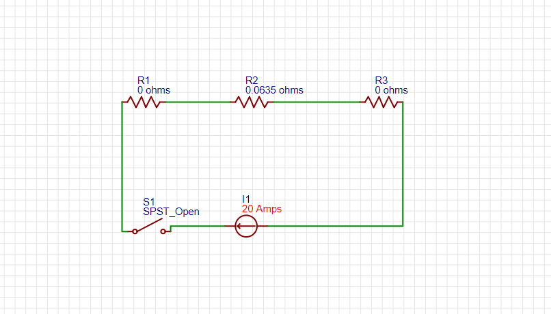
Electrolysis Power Circuit
R1 = R3
Nickel Mesh
R2
Salt Water
Notes:
Grant 1.25 in by resistance of saltwater 2 ohms per meter

Slide 22
Electrolysis Summary
Requirement | Design | Expected Performance | Verification
6.1 | The hydrogen and oxygen will be separated at creation | 100% | Fuel Cell Runs
6.2 | The system was designed to be sandwiched together into different layers making it replaceable | Life of bolts used | It will come apart
6.3 | Ability to bolt together | The life span of seals | It will come apart
Notes:
Grant

Slide 23
Electrolysis Summary
Requirement | Design | Expected Performance | Verification
6.4 | Will be made of plastic | Nonconductive | Voltmeter
6.5 | Will use 12-gauge wire | Rated for 20 amp | National Electrical code
6.6 | Will set power supply to max 20 amps | Max 20 amps | Power supply read out
6.7 | Have and on off switch | 100% | System turns off
Notes:
Grant

Slide 24
Material Storage
Notes:
Titan

Slide 25



System Requirements
1.2
“The system must store 0.04 grams of hydrogen gas.”
4.1
“The material storage efficiency (hydrogen in vs. hydrogen out) must be at least 50%.”
Notes:
0.04 is 2x the amount needed for potential losses and must release at least half of the hydrogen going in

Slide 26
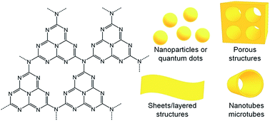
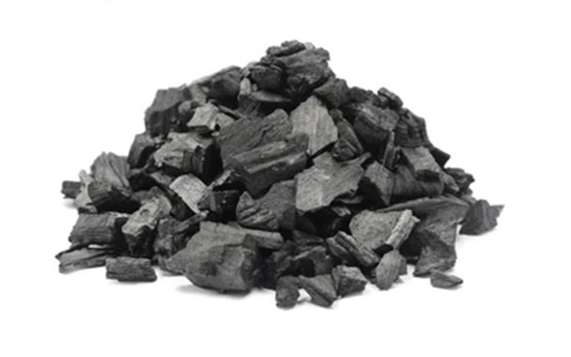
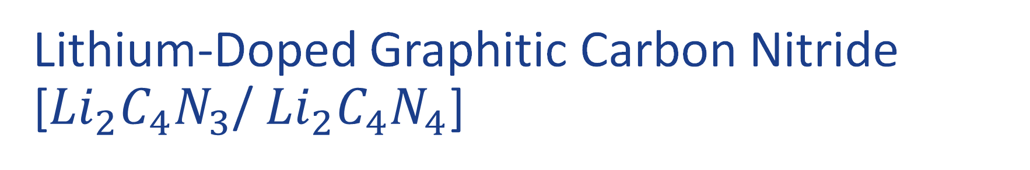
Lithium-Doped Graphitic Carbon Nitride [${Li}_{2}C_{4}N_{3}$/ ${Li}_{2}C_{4}N_{4}$]
Molecular Level
Naked Eye
Notes:
Dope with lithium to get maximum storage capacity, manufacturable on campus, hydrogen is absorbed at ambient conditions,

Slide 27
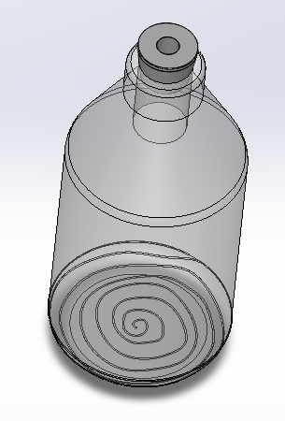
Subsystem Definition
Rubber Seal
The material storage subsystem is made up of a graduated bottle holding graphitic carbon nitride and rubber stopper to seal the bottle.
Graduated Bottle
Material Storage
Notes:
Hydrogen comes into the 1L bottle and then the storage is heated

Slide 28
Subsystem Requirements
7.1 Material storage must release 0.02 grams of hydrogen.
7.2 Material must store hydrogen with at least 2% weight of Hydrogen.
7.3 Must contain at least 2 grams of material storage.

Slide 29
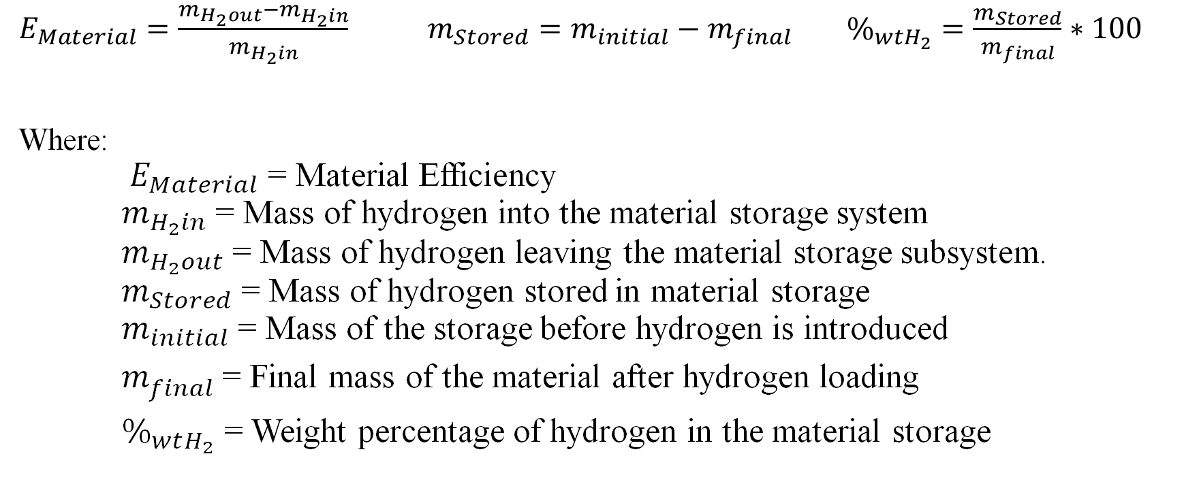
Equations
$E_{Material}=\frac{m_{H_{2}out}−m_{H_{2}in}}{m_{H_{2}in}}$ $m_{Stored}=m_{initial}−m_{final}$ $\%_{wtH_{2}}=\frac{m_{Stored}}{m_{final}}∗100$
Where:
$E_{Material}$ = Material Efficiency
$m_{H_{2}in}$ = Mass of hydrogen into the material storage system
$m_{H_{2}out}$ = Mass of hydrogen leaving the material storage subsystem.
$m_{Stored}$ = Mass of hydrogen stored in material storage
$m_{initial}$ = Mass of the storage before hydrogen is introduced
$m_{final}$ = Final mass of the material after hydrogen loading
$\%_{wtH_{2}}$ = Weight percentage of hydrogen in the material storage

Slide 30
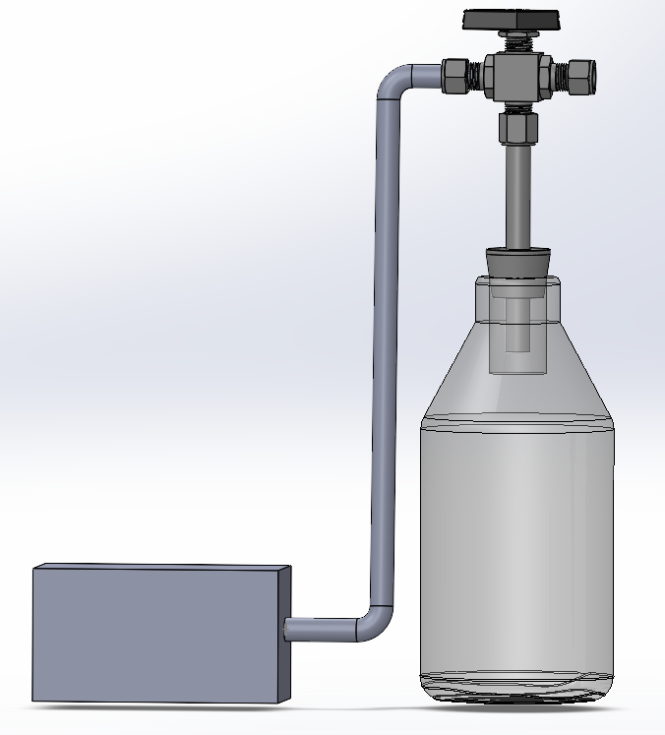

7.1 Release
Release Rate Testing
Scalable mass to increase hydrogen being released
Valve to contain hydrogen If slow release
Material Storage
Fuel Cell
Notes:
No current data on release rate, DOE funding research, easily scalable or contained

Slide 31

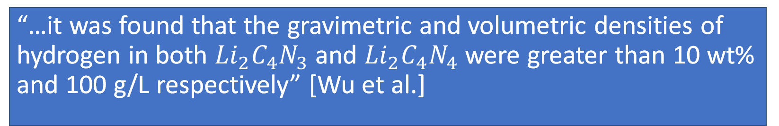
7.2 Material Capacity
“…it was found that the gravimetric and volumetric densities of hydrogen in both ${Li}_{2}C_{4}N_{3}$ and ${Li}_{2}C_{4}N_{4}$ were greater than 10 wt% and 100 g/L respectively” [Wu et al.]
Notes:
Minimum of 2%

Slide 32

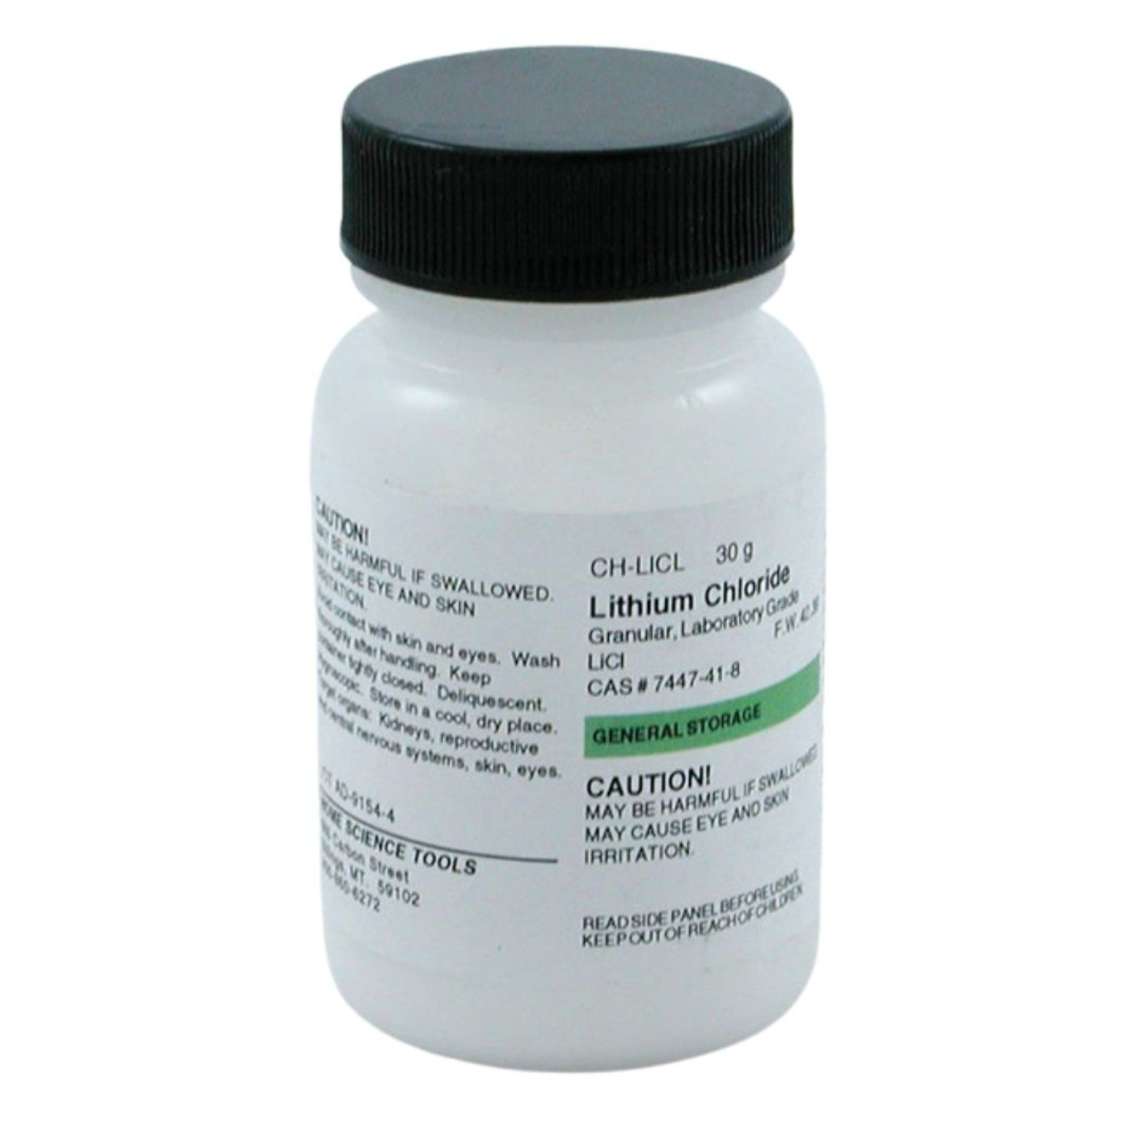
7.3 Material Needed
4% yield Urea to Graphitic Carbon Nitride
https://www.google.com/search?q=urea&rlz=1C1GCEJ_enUS1034&source=lnms&tbm=isch&sa=X&ved=2ahUKEwjL07Cd_dn7AhVxBEQIHctsDisQ_AUoAXoECAEQAw&biw=1920&bih=969#imgrc=uJswUlCxh-9elM
https://www.homesciencetools.com/product/lithium-chloride-30-g/
Notes:
Pyrolysis of urea

Slide 33
Storage Summary
Requirement | Design | Expected Performance | Verification
7.1 | Extraction heats material to release temperature | Releases at least 0.02 grams per 10 minutes | Runs the fuel cell
7.2 | Doped graphitic carbon nitride | Capacity of 10% wt hydrogen | Numerically, Greater than 2% Testing
7.3 | 2 grams of Graphitic Carbon Nitride | Synthesize 50 grams for 4% yield | Greater than 2 grams

Slide 34
System Interfaces

Slide 35

System Requirements
4.4
“all subsystem interfaces must be sealed.”
Notes:
Tesla

Slide 36
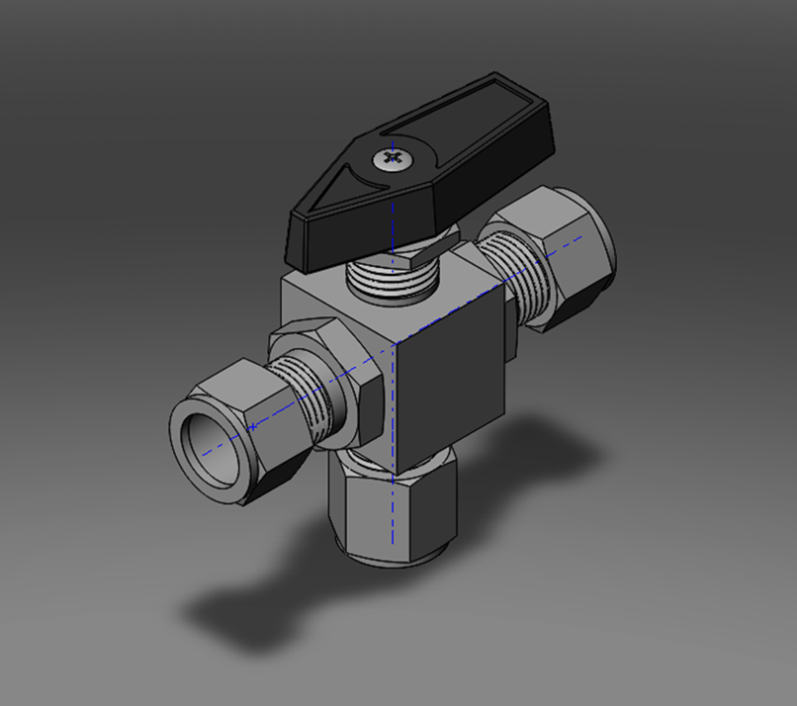
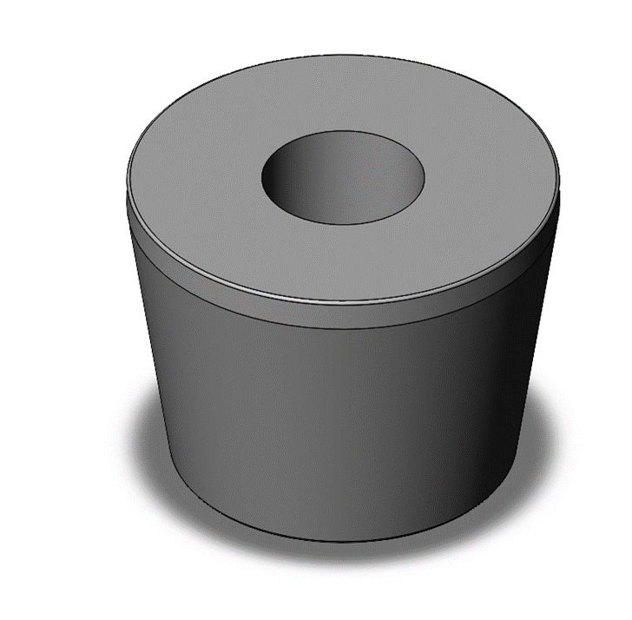
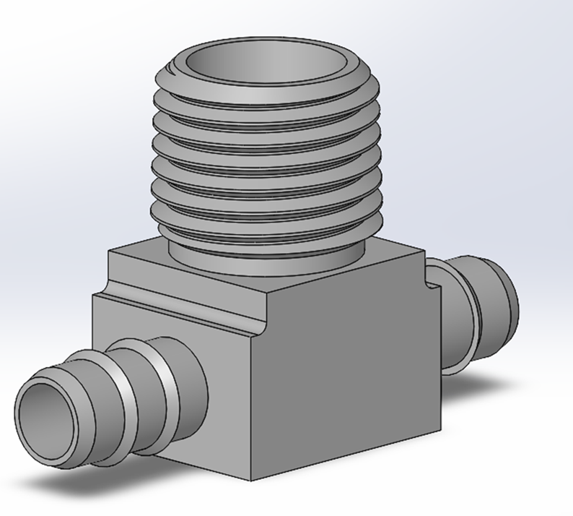
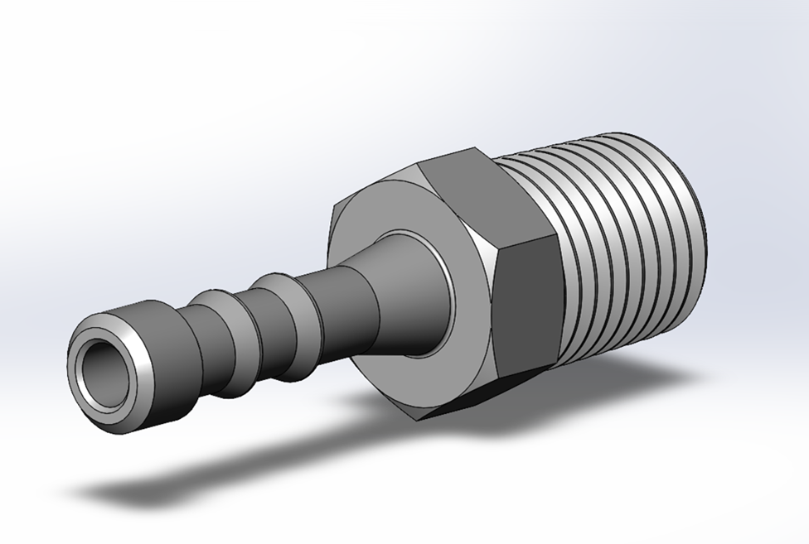
Interface Map
Rubber Stopper
.4375 in Through Hole
1 - 21/64 in
1 in
1 - 1/16 in
3-Way Diverting Valve, Brass
½ in OD Yor-Loks
3-Way Barbed Insert, Brass
Barbed Fitting, Stainless
¼ in OD
¼ in OD
¼ in NPT, 18 TPI

Slide 37
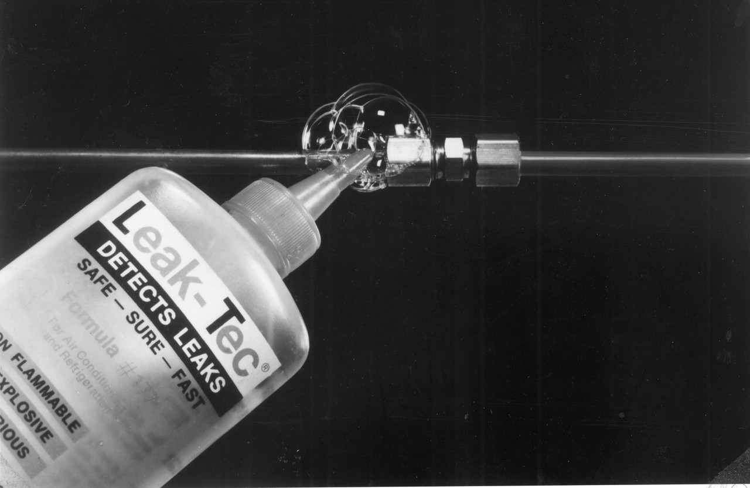
Detecting Leaks
ERH2 will follow ASHRAE Bubble Method under Chapter 29.9 Leak Detection in the 2017 edition ASHRAE Handbook.
Fast leakage test – Unitem Wrocław (unitemmachines.com)

Slide 38
Integration Summary
Requirement | Design | Expected Performance | Verification
8.1 | The electrolyzer fitting moves hydrogen gas from the electrolyzer to the piping. | No leaks | Bubble Test
8.2 | The pressure gauge fitting moves hydrogen gas from the piping to the pressure gauge. | No leaks | Bubble Test
8.3 | The rubber stoper fitting moves hydrogen gas from the 3-way diverting valve to the material storage. | No leaks | Bubble Test

Slide 39
Extraction

Slide 40

System Requirements
2.1
“The system must allow for safe extraction of hydrogen gas without risk of major leaks.”
4.3
“The material storage to fuel cell system must be able to run for 10 minutes.”
Notes:
Tesla

Slide 41
Subsystem Requirements
9.1 The heating system must be able to cause the material storage to off-gas hydrogen at a rate which yields a gauge pressure less than 2000pa gauge or 0.29psi gauge.
9.2 The heating system must be able to heat the storage material to 300°C and must not exceed 350°C.

Slide 42
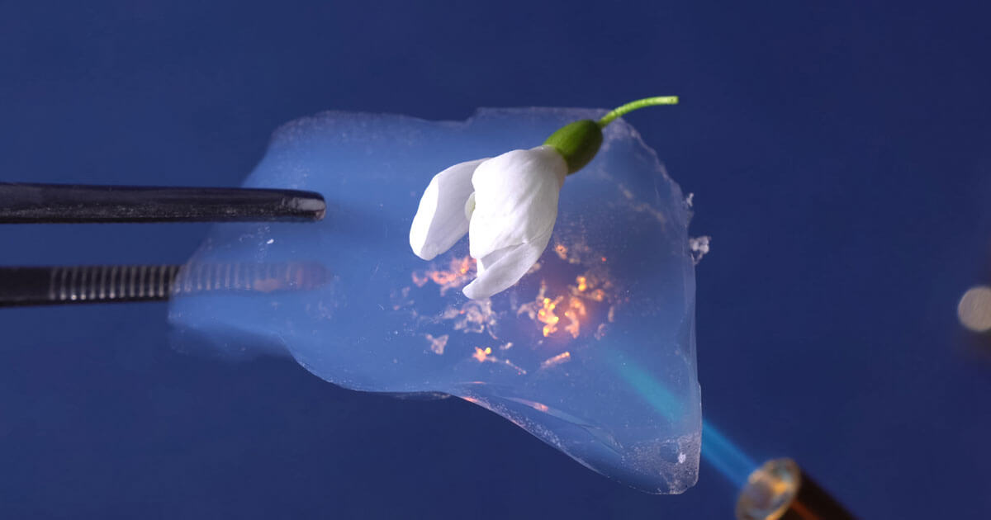

Heating Element – Nichrome Wire
Target Temperature: 300°C
Maximum Temperature: 350°C
Thermal Insulation:
Aerogel - 650 °C
-Remington Industries
Notes:
Include the insulating material Dr. Heine was proposing for it to sit on
Also how are we connecting it safely, claw clips?

Slide 43
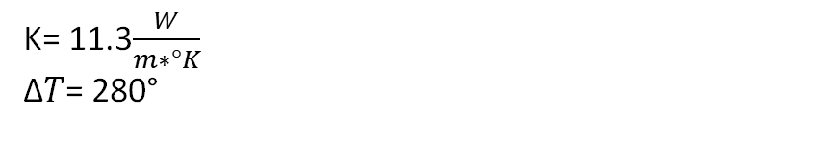
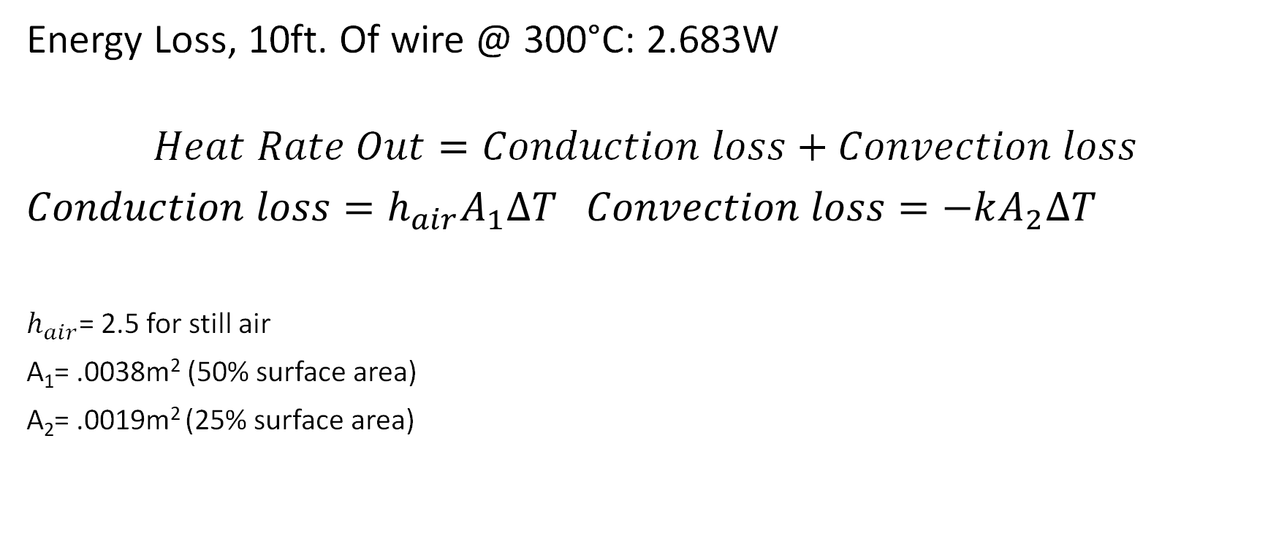
Heat Loss Calculations
Energy Loss, 10ft. Of wire @ 300°C: 2.683W
$$Heat Rate Out=Conduction loss+Convection loss$$
$Conduction loss=h_{air}A_{1}∆T$ $Convection loss=−kA_{2}∆T$
$h_{air}$= 2.5 for still air
A₁= .0038m² (50% surface area)
A₂= .0019m² (25% surface area)
K= 11.3$\frac{W}{m∗°K}$
∆𝑇= 280°

Slide 44
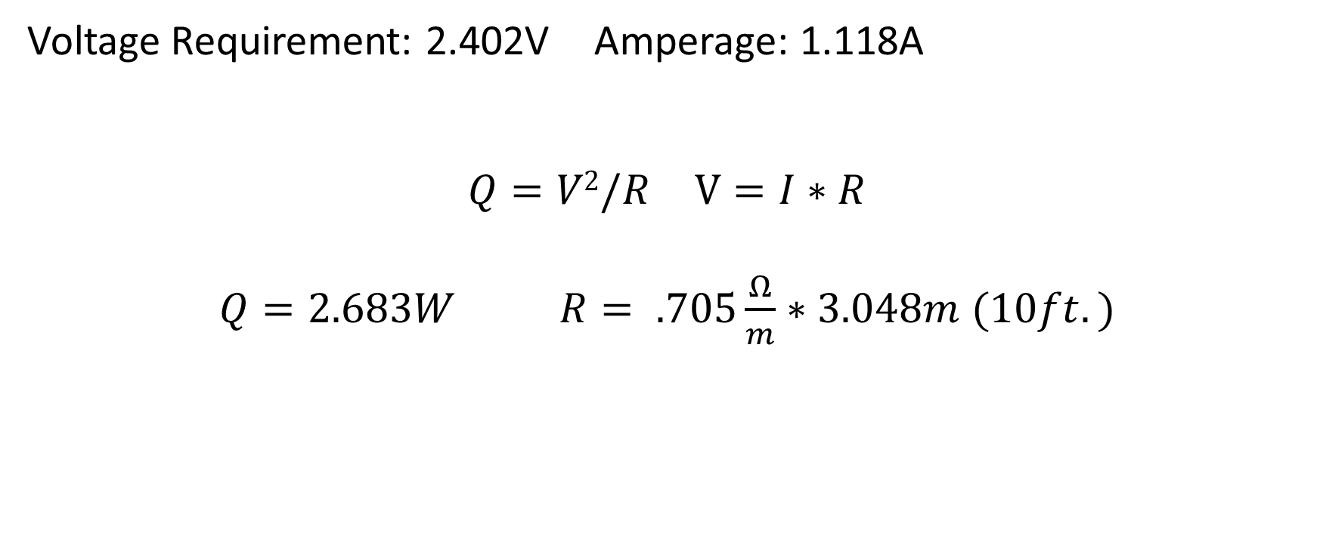
Power Input Calculations
Voltage Requirement: 2.402V Amperage: 1.118A
$Q=V2/R$ $V=I∗R$
$Q=2.683W$ $R= .705\frac{Ω}{m}∗3.048m (10ft.)$

Slide 45


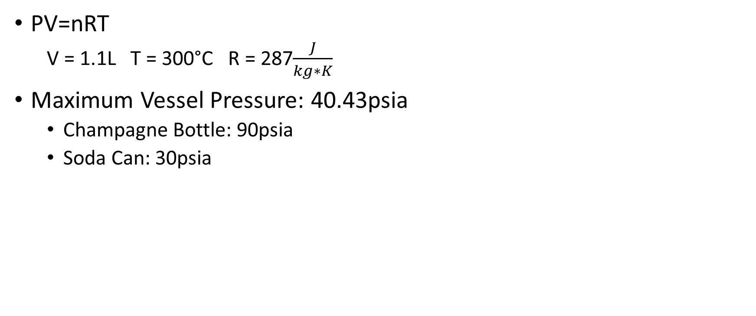
Vessel Pressure
PV=nRT
V = 1.1L T = 300°C R = 287$\frac{J}{kg∗K}$
Maximum Vessel Pressure: 40.43psia
Champagne Bottle: 90psia
Soda Can: 30psia

Slide 46
Extraction Summary
Requirement | Design | Expected Performance | Verification
9.1 | Nichrome wire achieves steady state temperature of 300°C | Hydrogen release from storage medium | Fuel cell produces electricity
9.2 | Voltage supplied to Nichrome wire ≈ 2.4V | Steady state temp. < 350°C | Thermal Camera (Propulsion Lab)

Slide 47
Piping
Notes:
Jacob

Slide 48
Piping Layout
PTFE Tubing
Copper Piping
Notes:
Chose PTFE for transportability
Chose copper for heat transfer

Slide 49
Subsystem Requirements
10.1 The subsystem must transport hydrogen gas from the electrolyzer to the material storage, and from the material storage to the fuel cell.
10.2 The subsystem must withstand internal pressures up to 0.29psi gauge without leaking.
10.3 The subsystem must withstand temperatures up to 350°C without leaking.

Slide 50
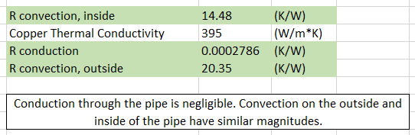
Heat Transfer Analysis
Use a 6in long pipe at constant 100°C that reduces internal gas temperature from 300°C to 150°C to determine flow regime.
Analyze 0.0001in long sections where pipe is average temperature of internal and external air.

Slide 51
Piping Requirement Summary
Hard Copper Pipe 0.5”OD x 0.05”Wall Thickness x 2.63” Long
PTFE Tubing 0.31”OD x 0.03” Wall Thickness x 2’ Long
Requirement | Design | Expected Performance | Verification
10.1 | PTFE tubing and copper pipe. | Transportation of hydrogen gas | Pressure gauge, mass of material storage, operation of fuel cell
10.2 | Material chosen to withstand pressures. | No leaks | Bubble method
10.3 | Copper piping sufficiently transfers heat. | Temperature reduced to 50°C at diverting valve | Thermal imaging

Slide 52
Interactive User Interface (IUI)
Notes:
Dylan

Slide 53
Subsystem Requirements
11.1 states that the system must include a pressure gauge integrated in the hydrogen piping
11.2 states that the system must include a scale to mass the material storage system
11.3 states that the IUI must have an infographic about hydrogen production, storage, and uses
11.4 states that the IUI must display all measured values
11.5 states that the IUI displays must display values in English units

Slide 54
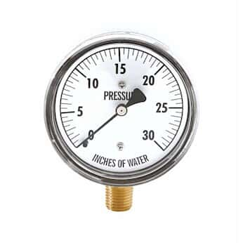
11.1 Pressure Gauge
0-30 inWC (0-1.08 psi)
±3-2-3% accuracy
0-7.5 inWC: ±0.9 inWC
7.5-22.5 inWC: ±0.6 inWC
22.5-30 inWC: ±0.9 inWC

Slide 55
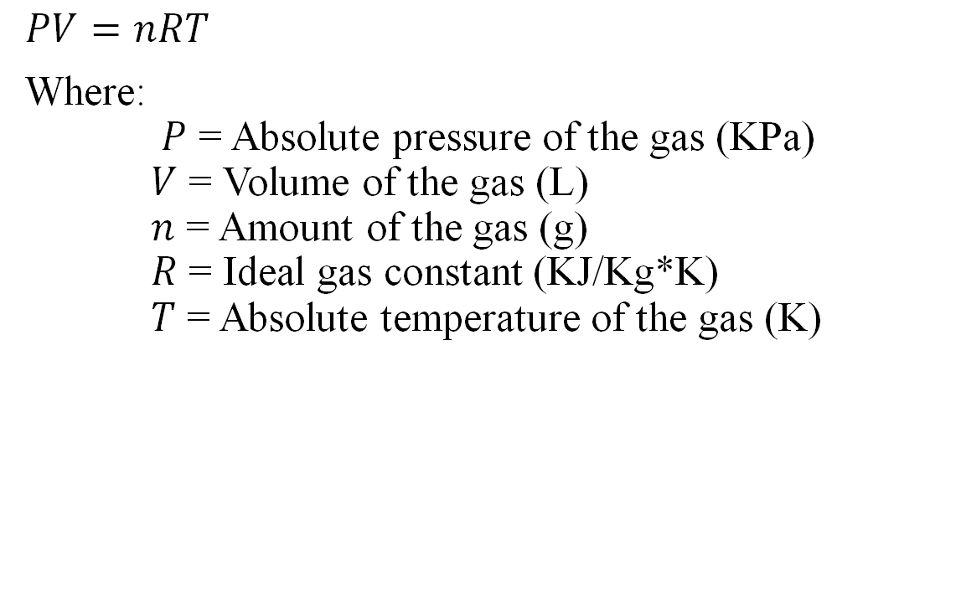
Governing Equations
In. wc | PSI | Grams of Hydrogen
0 | 0 | 0
1 | 0.0360912 | 0.000247124
2 | 0.0721824 | 0.000494249
3 | 0.1082736 | 0.000741373
4 | 0.1443648 | 0.000988497
5 | 0.180456 | 0.001235621
6 | 0.2165472 | 0.001482746
7 | 0.2526384 | 0.00172987
8 | 0.2887296 | 0.001976994
9 | 0.3248208 | 0.002224119
10 | 0.360912 | 0.002471243
11 | 0.3970032 | 0.002718367
12 | 0.4330944 | 0.002965492
13 | 0.4691856 | 0.003212616
14 | 0.5052768 | 0.00345974
15 | 0.541368 | 0.003706864
16 | 0.5774592 | 0.003953989
17 | 0.6135504 | 0.004201113
18 | 0.6496416 | 0.004448237
19 | 0.6857328 | 0.004695362
20 | 0.721824 | 0.004942486
21 | 0.7579152 | 0.00518961
22 | 0.7940064 | 0.005436735
23 | 0.8300976 | 0.005683859
24 | 0.8661888 | 0.005930983
25 | 0.90228 | 0.006178107
26 | 0.9383712 | 0.006425232
27 | 0.9744624 | 0.006672356
28 | 1.0105536 | 0.00691948
29 | 1.0466448 | 0.007166605
30 | 1.082736 | 0.007413729
$$PV=nRT$$
Where:
$P$ = Absolute pressure of the gas (KPa)
$V$ = Volume of the gas (L)
$n$ = Amount of the gas (g)
$R$ = Ideal gas constant (KJ/Kg*K)
$T$ = Absolute temperature of the gas (K)

Slide 56
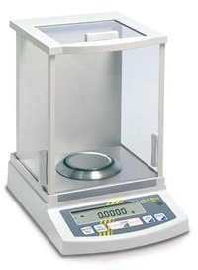
11.2 Mass Measurement
Chemistry lab scale to measure storage system mass
±0.0005 accuracy

Slide 57
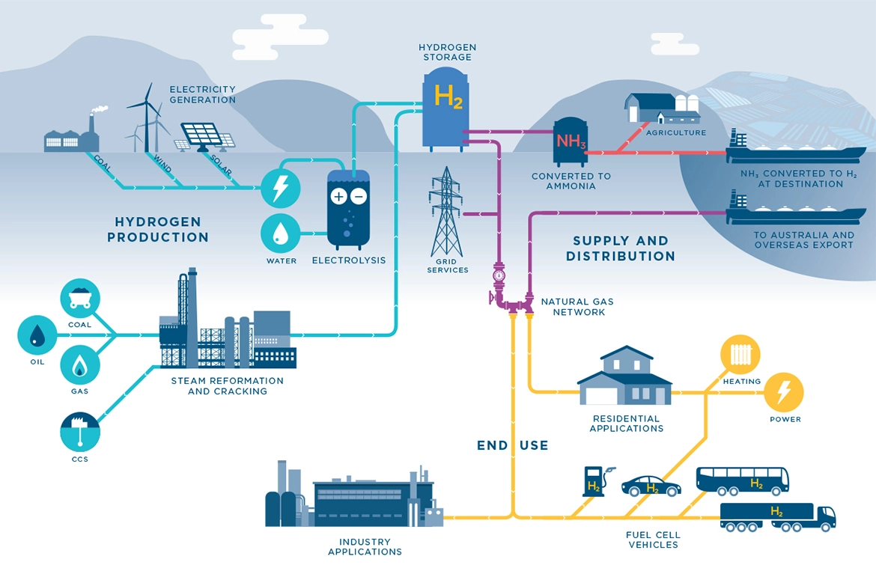
11.3 Infographic
Hydrogen Economy Infographic – Herbert Smith Freehills

Slide 58
IUI Summary
Requirement | Design | Expected Performance | Verification
11.1 | 0-30 inWC Pressure Gauge | Display accurate pressure of system | Visual Inspection
11.2 | Chemistry lab digital scale | Display mass of hydrogen in storage system | Visual Inspection
11.3 | Hydrogen Economy Infographic | Inform about hydrogen economy | Visual Inspection
11.4 | Pressure gauge and scale have measurement displays | Display measurements | Visual Inspection
11.5 | Pressure gauge and scale have English unit on the displays | English Units | Visual Inspection

Slide 59
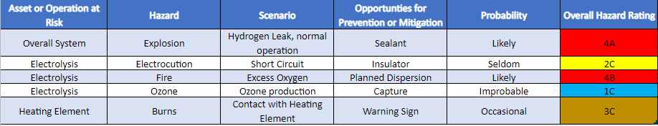
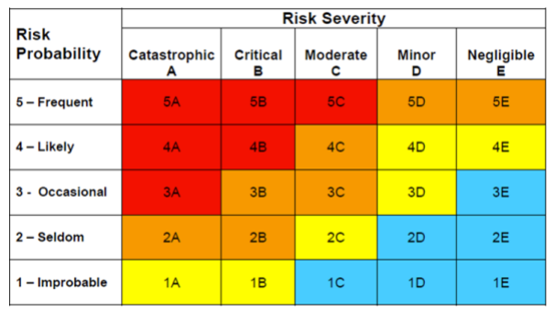
Risk Matrix – Before Mitigation
Notes:
Hannah

Slide 60
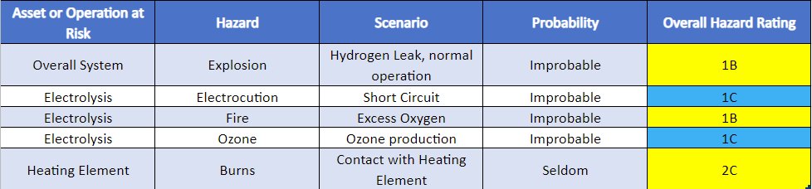
Risk Matrix – After Mitigation
Notes:
Hannah

Slide 61
Budget
Item | Cost
Shirts | $150.00
Urea | $20.00
lithium Chloride 30grams | $17.90
Plexiglass | $84.56
Pressure gauge | $35.65
Mesh X 2 | $22.00
PTFE Tubing x 25ft | $62.25
F-F Thread Adapter x2 | $19.12
Bolts | $7.60
Copper Pipe (2ft) | $5.49
Barbed T fitting x 2 | $24.28
Barbed Fitting x3 | 9.02
Graduated Bottle | 91.64
Nichrome Wire 20gauge x 50ft | $12.00
Solder | $30
Rubber Plug | $10.42
Rubber Tape (25ft) | 18.37
Diverting Valve | 123.84
Epoxy's | $30
nuts | $2.20
Other Plastic | $88.04
Power Supply | $289.99
Total
$1,154.37
Notes:
Hannah
Expenses are overestimates

Slide 62
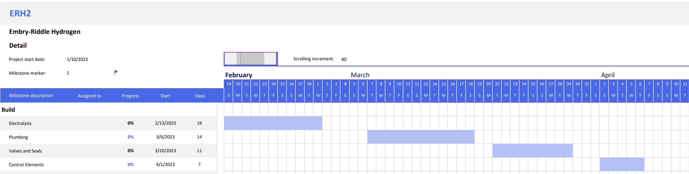
Schedule
Notes:
Hannah

Slide 63
Acknowledgements
Dr. Karl Heine
Dr. Johnathan Adams
Dr. Richard DiPietro
Dr. Istemi Ozsoy
Dr. David Lanning
AXFAB Staff
Taylor Spiller
Notes:
Hannah

Slide 64

Questions?

Slide 65
Additional Slides
Requirements
Generation
Natural Gas
Photobiological
Microbial Biomass conversion
Storage
Physical
Material
Equations
Graphic Design
Schedule

Slide 66

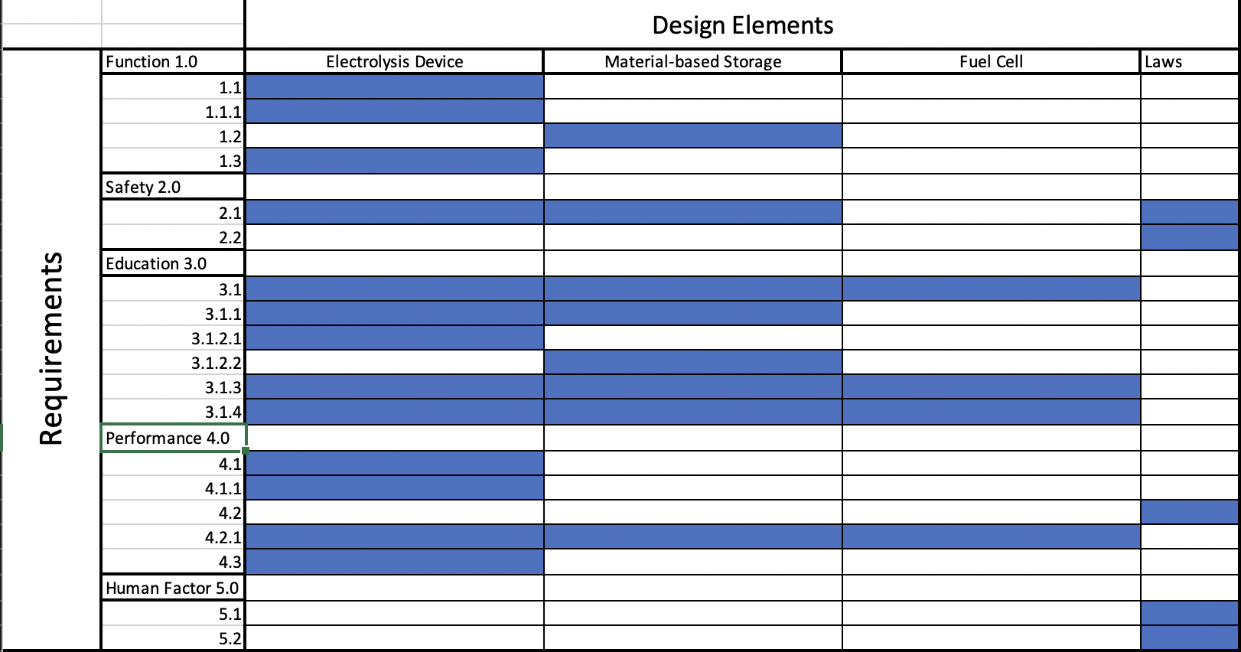
Requirements Matrix

Slide 67
Generation - Natural Gas
Methane Resource
Methane is collected from a source (usually from natural gas)
Steam-Methane Reforming
High temperature steam (at 700-1,000 °C) is added to the methane gas
Hydrogen Extraction
Hydrogen gas is extracted from the steam-methane mix from an added catalyst
Notes:
The common catalyst used for steam-methane is typically nickel but research has been done showing that the noble metals can also work. This process produces hydrogen gas, carbon monoxide, and a small amount of carbon dioxide. DOE did not specify how much CO2 was produced.

Slide 68
Generation - Photobiological
Bacteria Strain
Water is Supplied
Bacteria Uses Photosynthesis
Water is Broken Down into its Elemental Form
Hydrogen Gas is Released
Notes:
After a complete cycle, the bacteria will need some amount of filtration provided, before adding more water. This filtration will remove all nitrates and acidic biproduct chemicals that was produced during a full cycle. During this process the bacteria will consume a percentage of the hydrogen gas, making the gas production rates and net efficiency of the system low.

Slide 69
Generation - Microbial Biomass Conversion
Bacteria Strain
Hydrocarbon is Added
Bacteria Uses Fermentation
After Fermentation, the Bacteria Leaves Behind Several Elements
Hydrogen Gas can be Filtered Out.

Slide 70
Storage – Physical Storage
Compressed
5,000-10,000 PSI
Unique Pressure Vessels
Cryogenic
Liquid H2 at -252.2 °C
Solid H2 at -259.14°C

Slide 71
Storage – Material Storage
Adsorbtion
Hydrogen is Stuck to the Compound’s Surface
Absorption
Hydrogen is Encased by the Compound

Slide 72
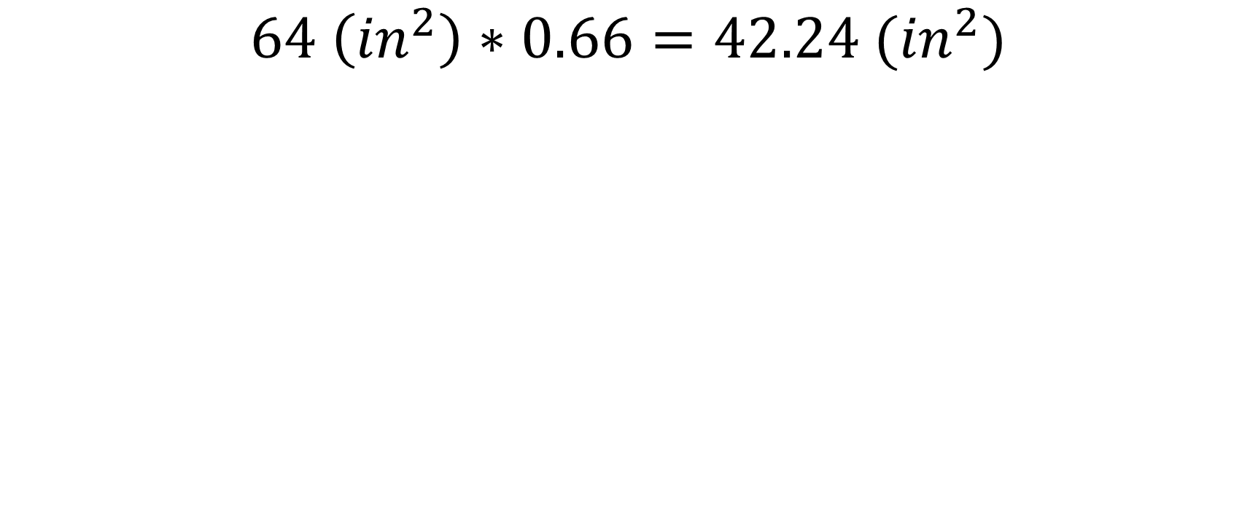
Equations – Area of Mesh
$$64 \left({in}^{2}\right)∗0.66=42.24 ({in}^{2})$$

Slide 73
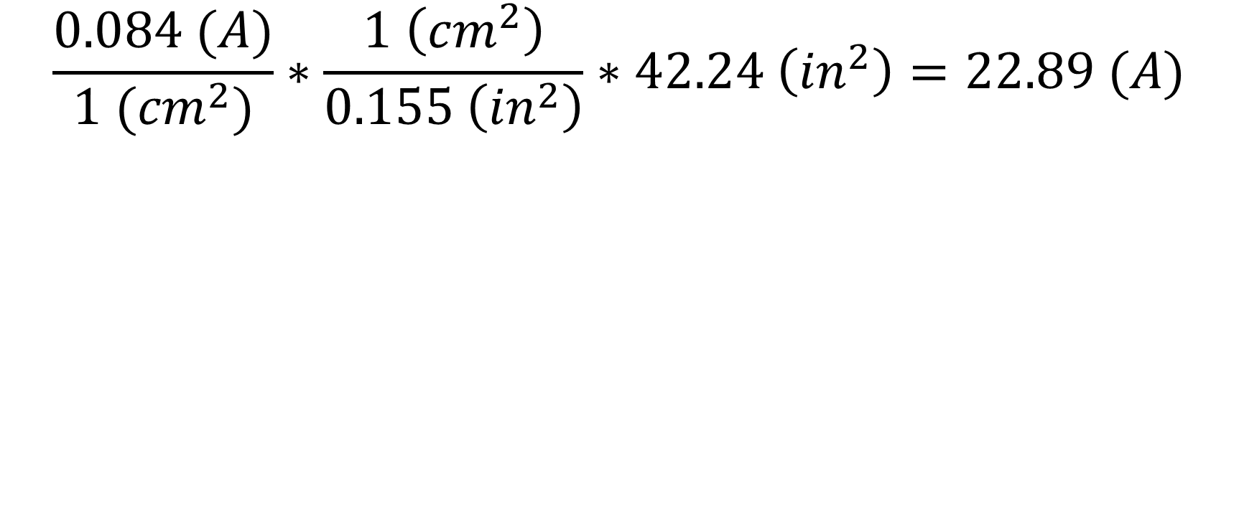
Equations – Max Current
$$\frac{0.084 (A)}{1 ({cm}^{2})}∗\frac{1 \left({cm}^{2}\right)}{0.155 \left({in}^{2}\right)}∗42.24 \left({in}^{2}\right)=22.89 (A)$$

Slide 74
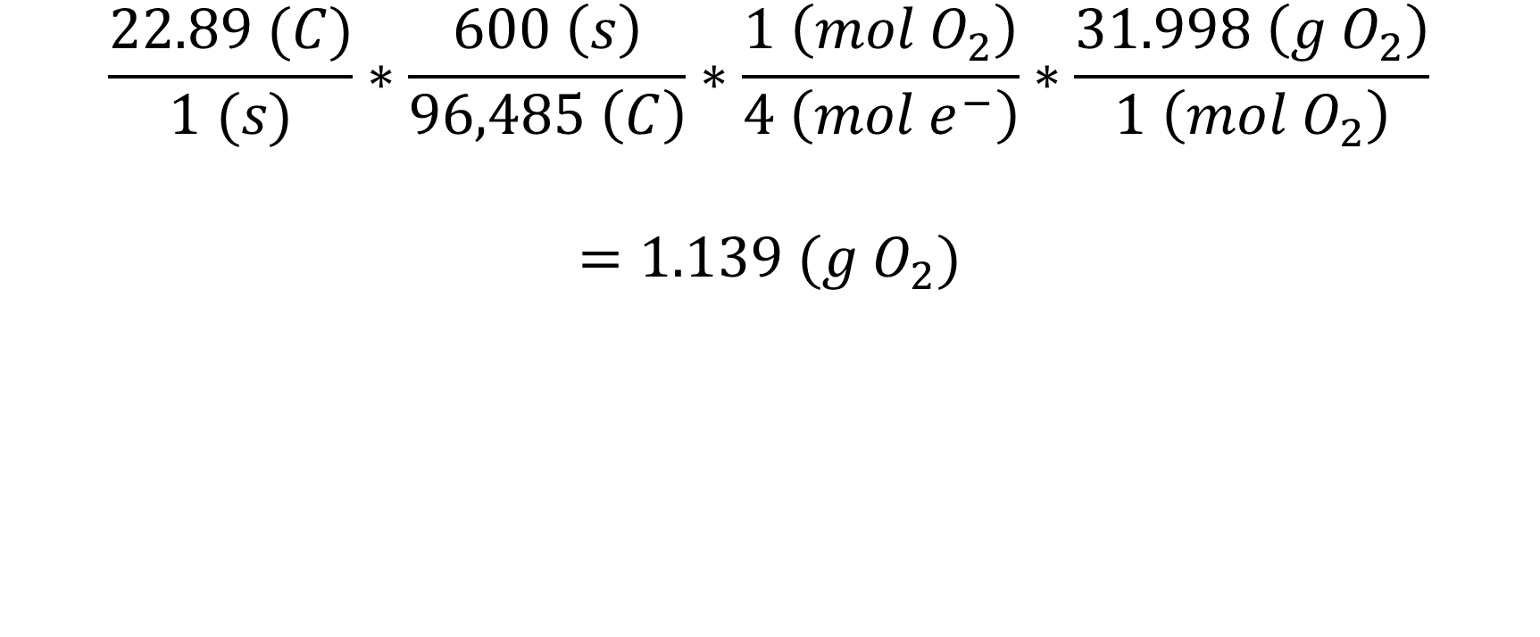
Equations – Rate of O2 Production
$$\frac{22.89 (C)}{1 (s)}∗\frac{600 \left(s\right)}{96,485 \left(C\right)}∗\frac{1 \left(mol O_{2}\right)}{4 \left(mol e^{−}\right)}∗\frac{31.998 \left(g O_{2}\right)}{1 \left(mol O_{2}\right)}$$
$$=1.139 (g O_{2})$$

Slide 75
Misc. Interfacing Table

Slide 76

Schedule of Project
Date tracking Gantt ERH2 (version 1).xlsb.xlsx

